Slide 1
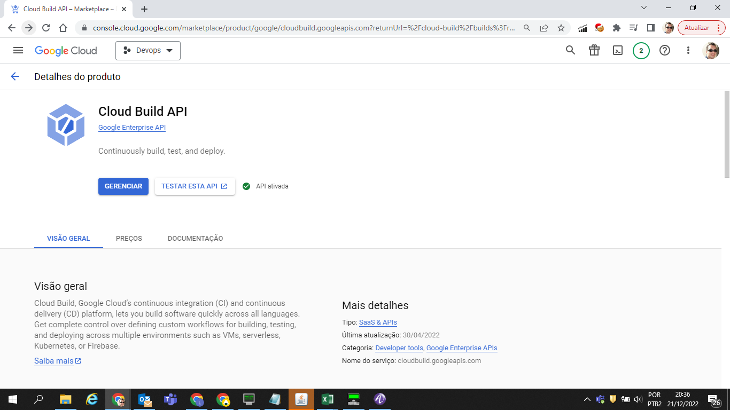
Habillitando Cloud Build API

Slide 2
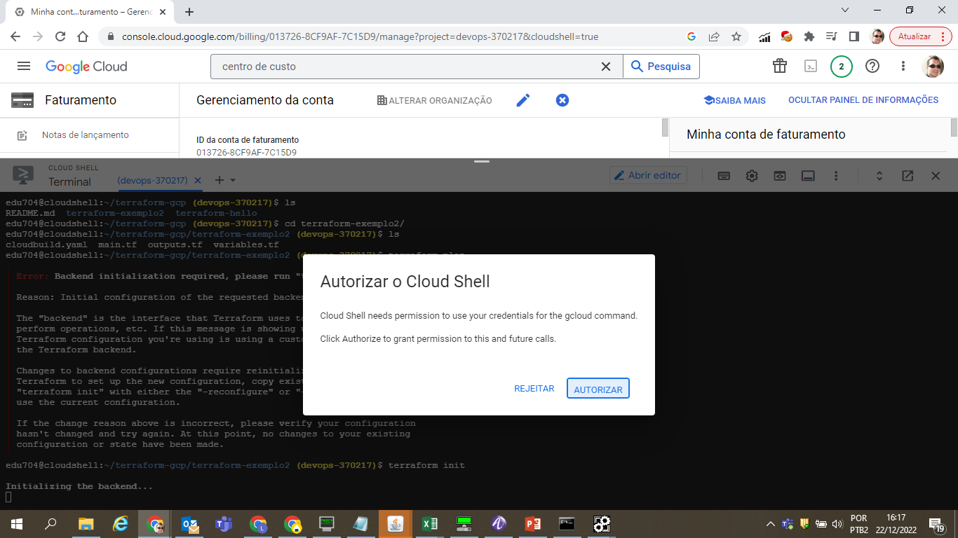
Iniciando Terraform

Slide 3
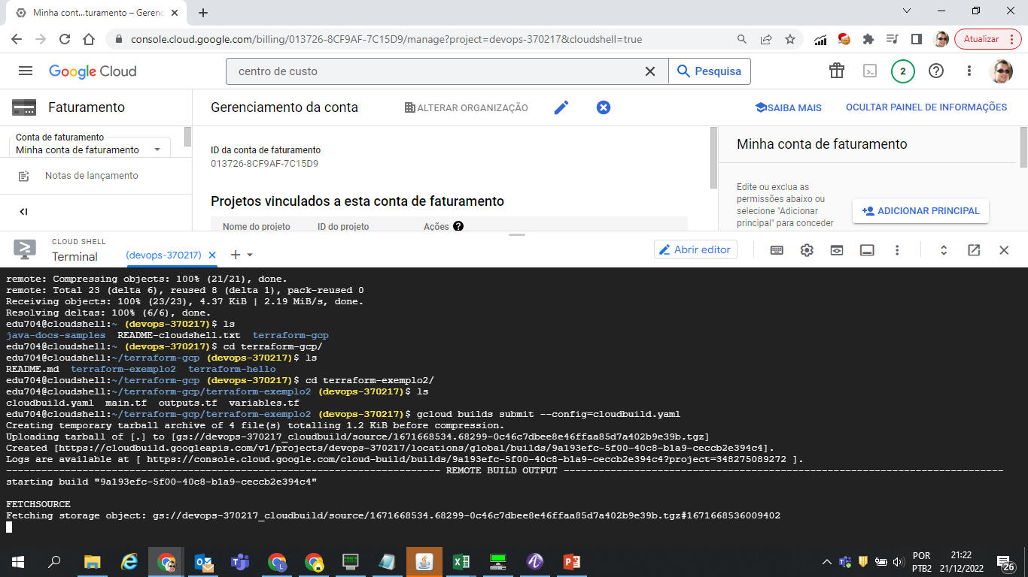

Slide 4
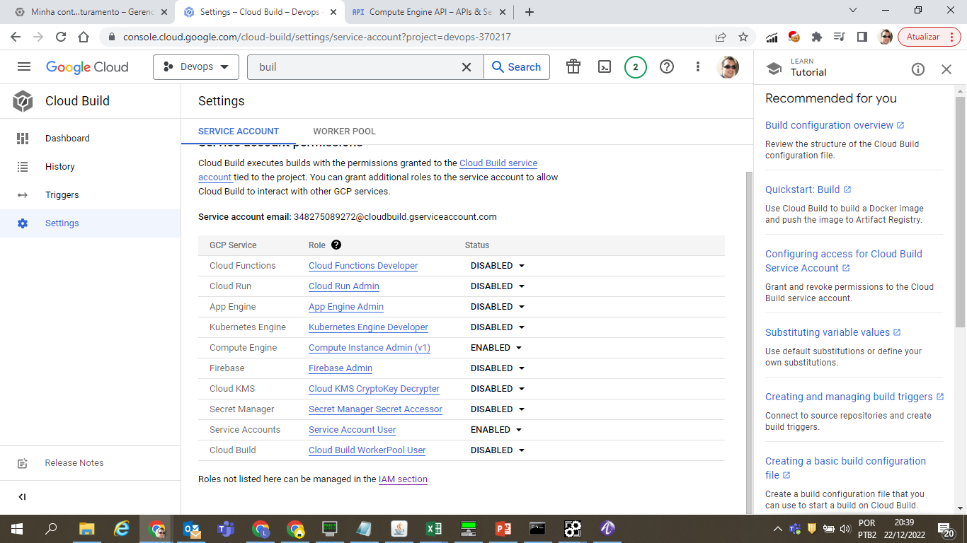
Habilitando service account e APIs

Slide 5
